Slide 1

NIDG ID26 Full Application Webinar Tuesday 14 October 2025
Notes:
Good afternoon everyone.
Yuma and Hello.
Thank you for joining us today for our National Intelligence Discovery Grants (NIDG), ID26 Full Application Webinar for funding commencing in 2026.
We would like to acknowledge the Traditional Owners of Country throughout Australia and the continued connection to lands, waters and communities.
We pay our respects to Aboriginal and Torres Strait Islander cultures and to Elders past, present and emerging.
We extend that respect to Aboriginal and Torres Strait Islander people viewing the webinar.

Slide 2
Presentation Topics
Key details and dates
Creating the full application in RMS
Intelligence Challenges and Technology Readiness Level
Personnel, Organisations and Eligibility
Preparing Your Application
The Selection Process
Post-Award Requirements
Common Questions
Notes:
Firstly, we would like to congratulate all participants who were successful with their Expression of Interest for this round.
Our focus today is not on the NIDG policy objectives, the Intelligence or how to use RMS as that was covered in the EOI and further information is available in the documentation available on GrantConnect, though we will touch on some of these things.
Instead, our aim with this presentation today is to help address common questions and to help avoid common pitfalls in completing and submitting an application.

Slide 3
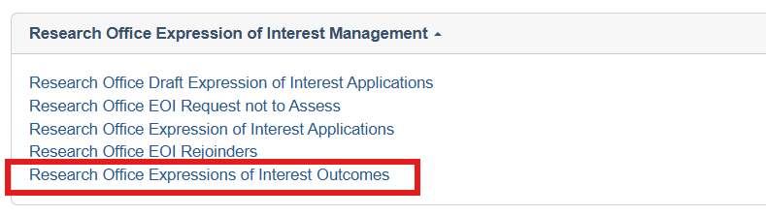
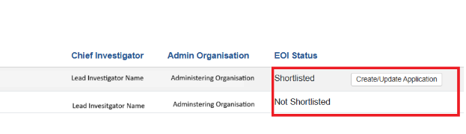
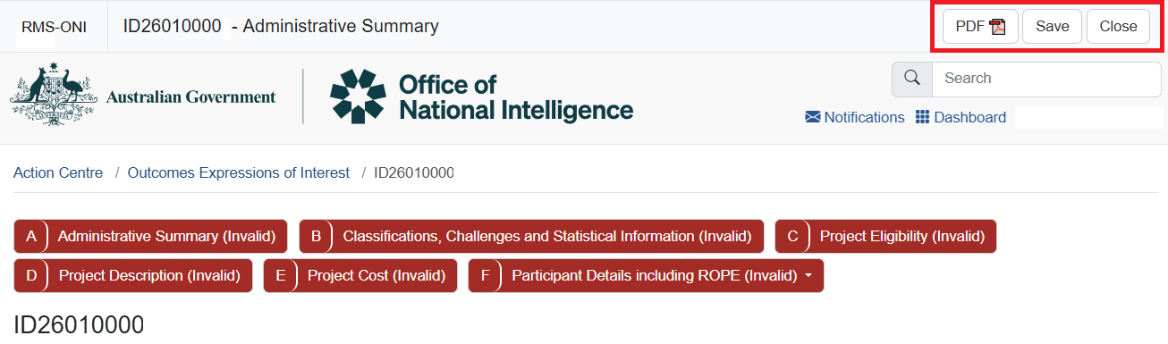
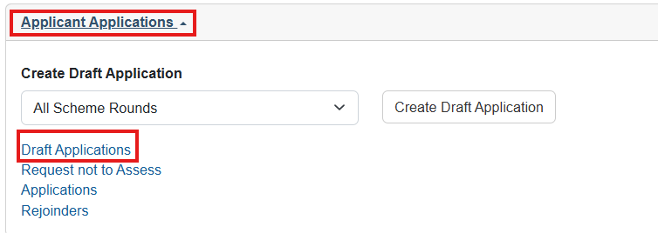
Create Full application in RMS
The Research Office must create the Full application in RMS
Notes:
For successful Expression of Interest applicants your Research Office will create the draft full application form in RMS for you to complete.
Once the application form has been created by the Research Office, the Lead Investigator on the EOI application will find the draft application form in RMS under Applicant Applications.
The purpose of the full application is to expand on your EOI.
To assist with completing the application form, some information entered in the expression of interest form will flow across to the application form. These fields will be editable if you need to change, update or add information.

Slide 4
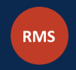
Grant Opportunity details
www.researchgrants.gov.au
Full application supporting documentation including FAQ’s is located on GrantConnect - https://www.grants.gov.au/
Grant Opportunity: GO7888
Applicants that have been successful through the Expression of Interest (EOI) can submit a Full Application in the ONI RMS portal under Applicant Applications:
rmsoni.researchgrants.gov.au
Notes:
All the relevant documentation for this Grant Opportunity can be found on GrantConnect including the frequently asked questions
Please be aware that FAQs will be updated as needed.
To make sure you are aware of any updates to the FAQs, or any other documentation, please register on GrantConnect and download the latest Grant Opportunity documentation. This will also enable an email notification when addenda or changes are issued.
GrantConnect also has a link to the ONI RMS portal from the Grant Opportunity page.
The ONI RMS Portal link can also be found on the Research Grants website: researchgrants.gov.au. When you go to the website you will see the orange RMS button and that will take you to a page with individual portals including the link to ONI’s portal.
If you have any trouble accessing RMS, such as issues with your MFA, please contact RMS support on PH: 02 6287 6789 or Email: rmssupport@arc.gov.au

Slide 5


Application warning messages and help text
Notes:
To assist in application eligibility, the application form in RMS has included warning messages.
As an example, these screenshots show the RMS application form checks in question A2 – Person Participant Summary and A3 Organisation Participant Summary for CI eligibility. These particular error messages will clear once the investigator completes questions in Part F.
Other error messages will appear throughout the form to guide you in completing the question correctly. If you are unsure please refer to the help text (the blue information icon above the question) or the ITAs, which are available for download on GrantConnect.
All eligibility requirements are contained in the Grant Guidelines and matters that would cause an error message are detailed in the ITAs on Grant Connect.
If you are having trouble with error messages you can reach out to your Research Office in the first instance.

Slide 6
Important dates for NIDG Grants
Key dates for the program are on the RGS website – researchgrants.gov.au/index.php/key-dates-nisdrg_nidg
Request Not to Assess (RNTA) close 21 November 2025
Full Applications close 5 December 2025, 5:00pm (AEDT)
Rejoinders 19 February to 5 March 2026
Notes:
Dates that you should be aware of for this application round are:
Applications are currently open (since 7 October 2025)
Request not to Assess submissions are also currently open and close 5:00pm (AEDT) 21 November 2025
Full Applications close 5 December 2025, 5:00pm (AEDT)
Rejoinders will open from 19 February 2026 to 5:00pm (AEDT) 5 March 2026
Important dates can be found on the Research Grants Services website and GrantConnect
Please note that the University Research Office that is the Administering Organisation of the application may have earlier dates for submission to allow for internal reviews prior to submitting to ONI.

Slide 7
Grant funding
Funding Period: 1 year (minimum) up to 3 years (maximum)
Funding Level per grant: $400,000 to $800,000
There is no indexation or funding top-ups
Applicants should build salary indexation into the requested funding
Consider personnel and the citizenship eligibility limitations
Consider a reduced project period to allow for higher funding each year
 | Minimum | Maximum
Per Year | $100,000 | $400,000
Per Grant | $400,000 | $800,000
Notes:
The total funding available per project is $800,000 which includes the Fellowship and Scholarship awards:
Funding can be sought for projects between 1 and 3 years.
The minimum funding that can be requested per year is $100,000 – maximum $400,000.
The minimum total funding that can be requested per grant is $400,000 – Maximum $800,000.
There is no indexation of the grant funding therefore you must include any indexation, salary increases or anticipated cost increases in the budget.
It is anticipated that the available funding envelope will allow 10 grants to be funded by ONI.
When determining your budget:
Consider the funding available and the tasks you can complete with that funding and period.
Should you consider reducing the number of years to increase the funding requested each year to complete certain tasks of a larger project?
Consider the personnel (eligible CI’s, Post Docs, PhD Students) that will be engaged on the project.
Are the funds you will be requesting sufficient to pay the personnel to complete the tasks?
All personnel associated with the project MUST meet the Citizenship eligibility criteria. That is: an Australian citizen, Australian Permanent Residents or New Zealand Special Category Visa holder
All personnel receiving funding from ONI must meet the citizenship eligibility criteria
All Personnel that would be named on publications from the project must meet the citizenship eligibility criteria.
The cohort of people that can work on your project is limited to those that meet the citizenship eligibility criteria which may affect competition for the personnel available to work on the Project.
Ensure suitable remuneration for personnel is requested in each year of the budget.
Failure to recruit as planned may jeopardise your grant funding.

Slide 8
Intelligence Challenges
You must select and address at least one and no more than three of the following nine Intelligence Challenges:
Covert collection challenges
Space-based technology challenges
Identity management challenges
Emerging biological science challenges
Emerging material science challenges
Cyber security, protective security and physical security challenges
Human behaviour and influence challenges
Data-driven and real-time analytical challenges
Situation awareness and multi-source assessment challenges
Notes:
Intelligence Challenges have been updated from previous rounds.
At least one of the nine challenges must be addressed in the application
A maximum of 3 challenges can be selected in the application
You must provide an explanation for each challenge selected, on how the project will significantly advance the science and technology area pertaining to the Challenge selected
The challenges you featured in the Expression of Interest will be copied into the full application.
During the EOI process, ONI reviewed your project proposal and the associated challenges and they want you to expand your project description in the full application.
If you change your challenge areas, and therefore your project, be aware this may impact the success of your application.
However, if you feel your project more correctly aligns with a different challenge than that outlined in your original application you can select another challenge, or provide additional detail of how the project aligns to the selected Challenge.
Be aware that while your project scope may change slightly from the EOI, major changes to your proposed project scope might not be supported by ONI.
Your EOI project description was determined as aligning with the selected Intelligence Challenges, so if you change the scope the project may fall out of alignment.
The success of your application will be determined by the full application only, the EOI will not be taken into account.
If you require further details about the Challenges, the Intelligence Challenge descriptions are available on GrantConnect or the Research Grants website.

Slide 9
Technology Readiness Level (TRL)
TRL 1
TRL 2
Applied Research
TRL 3
Critical Function or Proof of Concept Established
Basic Research
TRL 4
Lab Testing/Validation of Alpha Prototype Component/Process
TRL 5
Laboratory Testing of Integrated/Semi-Integrated System
TRL 6
Prototype System Verified
TRL 7
Integrated Pilot System Demonstrated
TRL 8
System Incorporated in Commercial Design
TRL 9
System Proven and Ready for Full Commercial Deployment
A scale to identify the maturity of research from Basic Research (TRL1) to System Proven and Ready for Full Commercial Deployment (TRL9).
Technology Readiness Level will help ONI to understand the Research and Development stage of the proposed research
Notes:
The Technology Readiness Level (or TRL) scale is used to identify the maturity of the research.
The scale is provided on the Defence website and a link to that page is provided in the Grant Guidelines, Grant Connect and the Research Grants Website.
The TRL will be used to provide the assessors and ONI a guide to the maturity of your proposed research.
Ensure you select the estimated TRL of the project at commencement of the project, not where you hope the project will finish in three or more years.
Remember ONI are looking for projects which are fundamental in nature, that is blue sky or basic research, with a TRL of between 1 and 3.

Slide 10
Personnel citizenship requirements
Grant Personnel must meet the following criteria:
Australian citizen or
Australian permanent resident, or
New Zealand Special Category Visa holder
Personnel
All named personnel
Support Personnel and students receiving an Award, salary or stipend from the grant
Individuals who will be named in publications or will otherwise link their association with this Government funded project.
Notes:
In the EOI, we only asked for one person to be named.
For the full application, you will include the full team. For your application to be eligible you, other participants, and organisations must meet the eligibility criteria.
To apply for, and during the life of the grant, personnel working on or associated with the project must meet eligibility criteria including citizenship:
The Citizenship Eligibility Criteria is
An Australian citizen or
An Australian permanent resident or
A New Zealand Special Category Visa holder.
This citizenship criterion is required for
all personnel named on an application must meet this citizenship eligibility criteria
Support personnel and students receiving a fellowship, scholarship, salary or stipend from the grant must meet the citizenship eligibility criteria.
Individuals who would be named in publications or would otherwise link their association with the Government funded project must meet the citizenship eligibility criteria.
Keep these criteria in mind when deciding on who will be collaborating or working on the project to make it a success.
Form Requirements
Each named participant, whether a CI or PI, will be asked to enter details to support their citizenship eligibility. This information is used to verify citizenship or Visa status of each participant.
This may include an Australian Passport, Permanent Visa details or Australian Birth certificate. In RMS you will need to include the participants’ full name, as listed in the document, the document number, expiry date (where applicable) and upload a copy of the document (in PDF) and a document that includes a photo if not an Australian passport.
Providing the details you enter into the application form are from the one document (a current or expired passport) your details should be able to be verified. If there are any issues regarding your eligibility, we will contact you through the application’s administering research office.
This question and documents uploaded to RMS are not viewable by other investigators within your application or assessors of the application.
The question and uploaded documents are viewable by the Administering Organisations Research Office for the application. If we, or ONI, have questions about the document details we will contact the Administering
Organisations Research Office in the first instance.
Do not include participants employed through an Intelligence Organisation that is part of the National Intelligence Community or NIC.

Slide 11
Personnel requirements
The Project Leader (first named Investigator) must be engaged by the Administering Organisation for the period of the project activity including any post project reporting period.
At least one Chief Investigator – must be an employee for at least (0.2 FTE) or be a holder of an honorary academic appointment at an Eligible Organisation.
Other Chief investigators must be employed or engaged; or be the holder of an honorary academic appointment at an Eligible Organisation;
Other Organisations must have at least one (1) named participant
Notes:
The Project Leader (first named investigator) must be employed or engaged by the Administering Organisation.
Engaged means that a formal arrangement is in place that attaches the CI to the relevant eligible organisation. If not an employee, (i.e. they do not have a continuing position), the researcher must have access to research support comparable to employees e.g., an emeritus appointment for the entire period of the project.
The engagement must be in place at Grant commencement and continue for the entire project activity period. They do not have to be engaged or employed at the time of submitting the application to apply.
At least one Chief Investigator must be an employee for at least 20 per cent of Full Time Equivalent (0.2 FTE) at an Eligible Organisation; or be the holder of an honorary academic appointment at an Eligible Organisation:
An honorary academic appointment for eligibility purposes means a position that gives full academic status to the researcher, as certified by the Deputy Vice-Chancellor (Research) (or equivalent) in the application. The researcher must have access to research support comparable to employees e.g., an emeritus appointment.
Other Chief Investigators must be employed or engaged with an Eligible Organisation, or be the holder of an honorary academic appointment (as noted above) at an Eligible Organisation.
Partner organisations listed as an Other Organisation in the application must have at least 1 named participant on the application.

Slide 12
Personnel Awards
NIDG Fellowship – $80,000 (over the life of the grant)
- to support one Early to mid career researcher with less than 10 years since the award of their earliest PhD, including Allowable Career Interruptions.
NIDG Scholarship - $60,000 (over the life of the grant)
- to support a postgraduate researcher.
The Fellowship and Scholarship Awards must be identified in the budget.
Awards should be considered a top-up to a University salary.
Notes:
NIDG Provides Awards for salary support for early career researchers and postdoctoral researchers on the grant.
Fellowship award
The fellowship award provides salary support up to $80,000 per grant to support a named Chief Investigator with less than 10 years since the award of their earliest PhD, including Allowable Career Interruptions.
The fellowship award must be identified in Question A2 and in Year 1 of the budget and can be used as a salary top-up to funding provided by the University.
The fellowship award can be spent during any year of the project until the funding has been exhausted.
Fellowship holders must meet the citizenship eligibility criteria (Australian citizens, Australian Permanent Residents or New Zealand Special Category Visa holders).
You are only permitted to request one Fellowship Award per application.
Scholarship Award
The scholarship award provides salary support up to $60,000 per grant to support a postgraduate researcher to participate in the project.
The scholarship must be identified in the first year of the budget and can be used as a salary top-up to funding provided by the University..
The scholarship can be spent during any year of the project until the funding has been exhausted.
Scholarship holders must meet the citizenship eligibility criteria (Australian citizens, Australian Permanent Residents or New Zealand Special Category Visa holders).
You are only permitted to request one Scholarship per application.

Slide 13
Drawing a salary from an NIDG grant
Who can draw a salary from the grant
A CI with less than 10 years since the award of earliest PhD, including Allowable Career Interruptions who has been awarded a NIDG Fellowship
(one Fellowship only per grant)
Postgraduate researchers (salary plus one NIDG scholarship only)
Other personnel such as technicians and laboratory assistants
Who cannot draw a salary from the grant
Those that do not meet the citizen eligibility criteria
Chief Investigators with more than 10 years since the award of earliest PhD, including Allowable Career Interruptions
Partner Investigators (PIs)
Notes:
Who can draw a Salary from the Grant?
University Personnel including:
Research associates and assistants, technicians and laboratory attendants
HDR candidates, students
Other personnel
CIs with less than 10 years since the award of their earliest PhD, including Allowable Career Interruptions (known as the Fellowship Award)
Postgraduate researchers can receive salary and / or the Scholarship Award
All Personnel drawing a salary from the grant must meet the citizenship eligibility criteria
Salary support is not available for CIs with more than 10 years since the award of their earliest PhD, including Allowable Career Interruptions or Partner Investigators.

Slide 14
Organisation eligibility
Administering Organisation
Eligible Organisations
Other Organisations
All Organisations MUST be Australian
Organisations must not be part of the Australian National Intelligence Community (NIC)
Publicly Funded Research Agencies can be listed as Other Organisations.
Refer to the NIDG ID26 Grant Guidelines for further information
Notes:
Organisations eligible to be an Administering Organisation are detailed in the Grant Guidelines
All Other Organisations included in the application must be Australian Organisations – that is an Organisation that:
has its headquarters in Australia,
has a board with a majority of Australian citizens or Australian permanents residents, and
has an Australian Business Number (ABN).
There are no minimum cash or in-kind contributions requirements for any organisations named on the application.
Other Organisations must not be an Australian National Intelligence Community or (NIC) member entity. A list of the NIC organisations is available on the ONI website. oni.gov.au

Slide 15
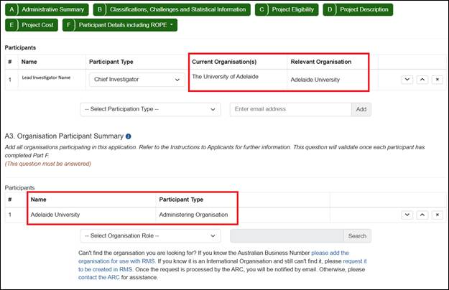
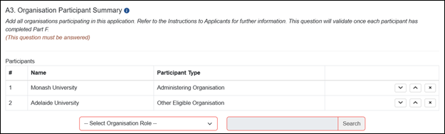
Adelaide University merger
The University of Adelaide or University of South Australia
are a participating as an Organisation or Investigator
Question A2 Person Participant Summary:
Current Organisation -This will remain as either ‘The University of Adelaide’ or ‘University of South Australia’, as this is auto populated from the participants’ Employment section of their RMS profile.
Question A3 Organisation Participant Summary:
Administering Organisation or Other Eligible Organisation
Select ‘Adelaide University’
Notes:
With the merger of The University of Adelaide and University of South Australia, to reduce administrative burden for successful projects we require you to select Adelaide University in place of either of the merging universities in several places in the application form.
In Part A of the form:
Question A2 Person Participant summary
There are 2 fields noting the current and relevant organisation of the participant.
The relevant Organisation is populated when the participant completes question F11.
Current Organisation is populated from the Employment section of the participants’ RMS profile. Current organisation can remain as either ‘The University of Adelaide’ or ‘University of South Australia’ for the application submission.
In Question A3 Organisation Participant Summary
Where either of the merging universities are participating as the Administering Organisation or an Other Eligible Organisation Select ‘Adelaide University’.

Slide 16
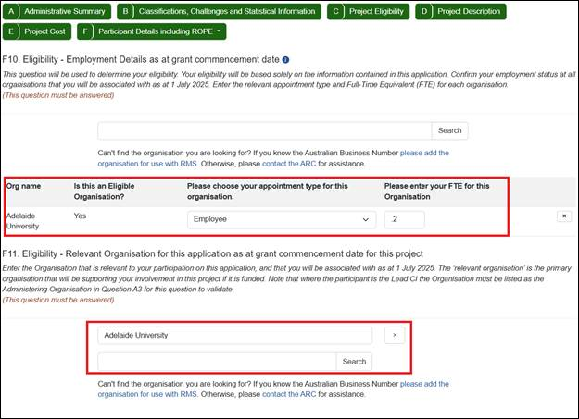
Adelaide University merger
The University of Adelaide or University of South Australia
are a participating as an Organisation or Investigator
Question F10 – Employment at Commencement Date
Select ‘Adelaide University’.
Question F11 – Relevant Organisation at Commencement date
Select ‘Adelaide University’.
Notes:
In Part F of the application form Participant Details, there are 2 questions where a participant from either merging university will need to select Adelaide University
Question F10 Organisation at Commencement Date, and
Question F11 Relevant Organisation:
Select ‘Adelaide University’ for both of these questions.
Further Details are available in the ITAs including screenshots to help you complete these questions correctly.

Slide 17
NIDG Assessment Criteria
Project quality and benefit 60%
Investigator(s)/Capability 25%
Feasibility and commitment 15%
Think about
- assessment criteria
- alignment with the challenges
- project outcomes and
- the audience
Notes:
There are three Assessment Criteria that applications are scored against, and details of each assessment criteria are outlined in section 6 of the Grant Guidelines.
Your applications is scored against the assessment criteria. Make sure you that your application demonstrates achievement against the Selection Criteria.
Go back over the guidelines when you are completing you application and consider the points regarding how you would demonstrate each of these criteria and think about the weighting of each of the criteria.
Think about how your project supports the NIDG Program outcomes and objectives and the relevant Challenges.
The alignment with Challenges and any different view of the expected TRL at commencement will be commented on by the detailed assessors, and their comments will be visible through the rejoinder process.

Slide 18
Important considerations
When drafting your application think about how an assessor might consider:
How the objectives and outcomes of your project support the aims of the NIDG scheme
How your project addresses the selected Intelligence Challenges
Think about the audience you are writing for:
Selection Advisory Committee
- who will not necessarily be experts in your specific area of research
ONI and the National Intelligence Community (NIC)
- who want to see the novelty and relevance of the proposed research against the selected Intelligence Challenge(s)
Notes:
Think about the audience you are writing for:
The Selection Advisory Committee who shortlists for research excellence, will not necessarily be experts in your specific area of research. Write to a highly capable research assessor who may not be a specialist in your field.
ONI and the National Intelligence Community – who want to see the novelty and relevance of the proposed research in the context of the program and the challenges.
Other things to think about:
The gap in current knowledge or significant problems, innovation, clarity of theories, cohesiveness of the project design in your proposal.
ROPE, time and capacity of the team, experience and capability of the team, ability to recruit support staff. Remembering that the pool of suitable, eligible personnel may be limited due to the citizenship eligibility criteria.
Cost effectiveness, environment in which the research will be conducted, availability of facilities and design.
Value for money

Slide 19
Assessment process
Application
Detailed and General Assessor Assessment
Rejoinder
General Assessors
Announcement
ONI for consideration and selection
Meritorious applications
Selection Meeting
Notes:
This slide shows the selection process for these applications:
Submitted Applications will be reviewed and assessed by Detailed Assessors.
Detailed Assessors will provide comments against the assessment criteria and how you have addressed the Challenges and the TRL selected in the application.
In parallel, General Assessors will review and assess your application and apply a preliminary score against the selection criteria
Applicants will be provided the Detailed Assessment comments and be given the opportunity to submit a Rejoinder to respond to comments from the Detailed Assessor noting this should not provide any additional information that was not included in the application.
A Selection Advisory Committee (of General Assessors) will reassess and discuss the applications, including information from Detailed Assessors and Rejoinders, and provide a shortlist of meritorious applications.
The shortlist of meritorious applications is provided to ONI for their consideration, selection and final approval.

Slide 20
ONI consideration and selection
ONI will review applications considered fundable by the SAC with respect to:
citizenship eligibility confirmation
fit with the Intelligence Challenges
the National Intelligence Community’s priority research needs
Australia’s national interest, including national security
projects already funded and the funding envelope available
Notes:
Applications shortlisted by the assessment process will be reviewed by ONI and the National Intelligence Community.
ONI will confirm eligibility of the shortlisted applications including the named personnel and review each shortlisted application. This includes alignment with the challenges and Technology Readiness Level selected in relation to the National Intelligence Community’s priority research needs and Australia’s national interest, including national security.
Applications will also be considered against projects already funded and the funding envelope available.

Slide 21
Funded Grants
Mandatory Security briefing prior to commencing the project
Grantees are required to develop KPI’s, a Recruitment Plan and confirm the projects Activity Budget
Reporting Requirements:
KPI report at project commencement
Six-monthly progress reports
Annual Project Expenditure Report (End of Year financial acquittal)
Final Report due six months after project end date
Regular outreach by ONI
Six monthly funding allocation payments
Attend Annual NIC summit in Canberra, hosted by ONI
Notes:
For applications that are successful and funded by ONI, here is an overview of some requirements you will need to complete during the life of the project.
All named personnel and research office staff assigned to the program will be required to attend a mandatory security briefing prior to commencing the project. This briefing will be hosted by ONI.
The Lead CI will be required to develop project specific key performance indicators in a KPI Report at the commencement of the Grant including a recruitment plan, which will be uploaded into RMS, and to submit six-monthly Progress Reports to report progress of the KPI’s.
As part of the Progress Report, you are required to include links to all publications developed under this grant.
Notify ONI when support personnel are recruited to the project and submit copies of their citizenship eligibility documentation
The Research Office on behalf of the project will complete an annual End of Year Report to advise the project expenditure (financial acquittal).
You will need to complete a Final Report within six months of the Project end date.
ONI will undertake outreach with the Project Investigators and the Research Office during the life of the project.
It is expected that you will attend a Conference hosted by ONI in Canberra annually
Please include the cost of travel to and from Canberra and accommodation for 2 nights into each year of your budget. This will provide you an opportunity to meet ONI stakeholders and network with other researchers.
The draft grant agreement is on grant connect.

Slide 22
Common issues and questions
Do ARC Grant limits apply to NIDG?
No, Grant limits do not apply
Does the ARC medical research policy apply to NIDG?
No, the ARC medical policy does not apply
How do we inform ONI of Investigator Citizenship eligibility?
Passport/Visa details are captured in RMS, including PDF upload of the relevant document
Do we need a new account in RMS to access the ONI RMS portal?
No, One login Permits access to ARC and ONI RMS Portals
Where do we find information about this Grant opportunity?
All relevant documents are located on GrantConnect
Notes:
The following questions have come up frequently, so we thought it would be good chance to recap.
There are no grant limits that apply to NIDG, it is the responsibility of the investigators, and the University to ensure that named participants have capacity to contribute to the project as detailed in the application.
The ARC medical research policy does not apply to NIDG.
National Intelligence Community entity staff cannot be named as participants
Documentation confirming each investigators citizenship eligibility will be captured in RMS. Each named participant will need to upload a copy of their passport, Visa or Australian birth certificate in the application form. If the document does not contain a photograph another document with a photograph should be uploaded also. This could be a foreign passport or Australian drivers licence.
This information is safe in RMS and is not visible to assessors.
To access the ONI RMS portal you can use your usual ARC login
All documentation required to complete the application form is available for download on GrantConnect

Slide 23
International collaborations
Researchers can collaborate with parties outside Australia
Only divulge IP or discoveries from your research with those you intend to.
Projects are not deemed secret
Be aware of and use systems and regulations within the university.
Get to know your University counter foreign interference office
Do ONI encourage collaboration with start-up companies?
Yes.
Collaborative engagement with Australian start-up companies is strongly encouraged.
Liaise with your University start-up incubator and/or industry outreach facility
There is a question regarding foreign recruitment in the application form. Is this a duplication of the question already asked when I completed my RMS Profile?
This is not a duplicate question.
It is included specifically for use by ONI.
Please read the question carefully prior to answering.
Notes:
International collaborations
A. Researchers may discuss their projects with outside parties however, they should be mindful of not divulging potential IP or discoveries that should be retained for the benefit of Australia. The projects are not deemed secret but we suggest that the research be discussed with some care.
Please talk to your heads of department, make use of systems and regulations within the university. Contact your University’s counter foreign interference office to seek specific consideration of the proposal and advice re sharing and collaboration. ONI has advised that if you have questions about collaborations and partnerships, their advice, if any, will be dependent on your university’s foreign interference office assessment.
Remember when publishing with parties outside the research team they must also comply with the citizenship eligibility criteria.
Q. Do ONI encourage collaboration with start-up companies?
Yes. While developing the Application, collaborative engagement with Australian start-up companies is strongly encouraged. ONI suggests that in the development of your full application, you liaise with your
University start-up incubator and/or industry outreach facility, where appropriate.
Q. Is Question F4 Participant Foreign Collaborations a duplication of a question in F1 when I completed my RMS Profile?
A. No this is not a duplicate question. This question expands on the question asked in F1 and is included specifically for use by ONI. Please read the question carefully before answering and do not assume that because you answered no in your personal profile the same will apply here. Answers to this question will not be visible to assessors but will be reviewed by ONI.

Slide 24
My passport has expired or is due to expire. I am planning to apply for a new passport but for the purpose of citizenship proof in F3, will the expiring passport suffice?
Yes. Enter the information from a current or expired passport.
You have asked for ALL publications by each investigator to be listed in the application. How should I list my Publications?
Please provide an open access link to your publications. A citation list (title, authors, journal etc) of all publications uploaded in PDF.
Do Not attach individual publications to the application form.
What does the CI need to do to justify teaching relief?
Provide details of what the CI will be completing on the project during the teaching
Why can’t these activities be conducted without teaching relief
Discuss the availability of teaching relief with your University
What was the success rate EOIs in this round
The success rate of the EOI applications to full applications may be advised once the successful full applications are announced
Notes:
Q. My passport is due to, or has expired
A. Enter the details from the document whether the document is current or not. Do not include details from 2 separate documents as we will not be able to verify your details
Q. You have asked for ALL publication by the investigator to be listed in the application. How should I list my Publications? PRIORITY
A. You will note two questions in regards to Research Outputs listings in the application form under the ROPE section. The first (Question F20) requests your top 10 Career Best Research Outputs, which will be used in consideration of your application by assessors.
The second question (Question F21) has been requested by ONI and requests a list of ALL publications produced by the applicant. In response to this question please provide a citation list (title, authors, journal etc) of all publications using an open access link to the publications, the format of the PDF is up to the Investigator. ONI DO NOT require individual publications to be uploaded to the application form.
ONI do check so make sure you include everything.
This full list of publications is not viewable to Assessors
Q. What does the CI need to justify teaching relief?
A. The availability of teaching relief for a CI needs to demonstrate value for money. It is important to justify what the CI will be completing on the project during the teaching relief and why these activities cannot be conducted without teaching relief.
Q. What was the success rate EOIs in this round
A. Applications this round were very strong and it was a difficult decision for ONI and the National intelligence community to shortlist the successful applications
Success rate was 10.5% 520 EOIs were submitted of which 55 were shortlisted

Slide 25
More questions?
Refer to the following documents when completing your application
Grant Guidelines,
Draft Grant Agreement
Challenges
Instructions to Applicants and
Frequently Asked Questions
All relevant documentation is on GrantConnect – www.grants.gov.au
Researchers:
Contact your Research Office in the first instance
Applications in RMS are managed by the Administering Research Office
Research Offices:
Clarification may be sought from ARC-NIDG@arc.gov.au
Notes:
All relevant documentation is on GrantConnect including the FAQ’s which answers common questions we have received in the past – this document will be reviewed frequently and updated as required.
To ensure you are aware of any updates to the FAQs, register on GrantConnect and download the Grant Opportunity documentation. This will enable an email notification to you when documentation changes are issued.
Ensure you refer to the NIDG Grant Guidelines, the draft Grant Agreement, Challenges document, Instructions to Applicants and Frequently Asked Questions when completing your application.

Slide 26
Thank you
RGS Team
ARC-NIDG@arc.gov.au 02 6206 7206
ARC RMS Support Team
rmssupport@arc.gov.au 02 6287 6789
GrantConnect
www.grants.gov.au
Notes:
Researchers/Investigators:
If you have any questions contact the Research Office of your Administering Organisation in the first instance.
Research Offices:
Clarification may be sought from the RGS team at ARC-NIDG@arc.gov.au
RMS Support (password or MFA resets) contact rmssupport@arc.gov.au or phone 02 6287 6789
And as a final reminder - think about the audience you are writing for – the Selection Advisory Committee who shortlist for research excellence, who will not necessarily be experts in your specific area of research.
ONI, who need to see the novelty and relevance of the proposed research in the context of the program and the challenges.
We wish you well with your application.

